Slide 1
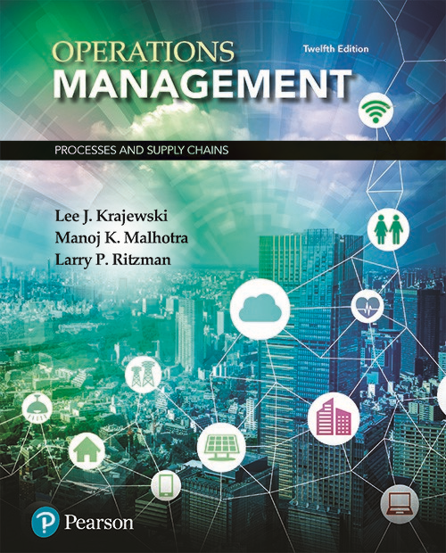
Operations Management: Processes and Supply Chains
Thirteen Edition
Chapter 3
Quality and Performance
Notes:
If this PowerPoint presentation contains mathematical equations, you may need to check that your computer has the following installed:
1) MathType Plugin
2) Math Player (free versions available)
3) NVDA Reader (free versions available)

Slide 2
Learning Objectives (1 of 2)
3.1 Define the four major costs of quality, and their relationship to the role of ethics in determining the overall costs of delivering products and services.
3.2 Explain the basic principles of Total Quality Management (T Q M) and Six Sigma
3.3 Understand how acceptance sampling and process performance approaches interface in a supply chain.
3.4 Describe how to construct process control charts and use them to determine whether a process is out of statistical control.

Slide 3
Learning Objectives (2 of 2)
3.5 Explain how to determine whether a process is capable of producing a service or product to specifications.
3.6 Describe International Quality Documentation Standards and the Baldrige Performance Excellence Program
3.7 Understand the systems approach to Total Quality Management (TQM)

Slide 4

Introduction
Notes:
The challenge for businesses today is to satisfy their customers through the exceptional performance of their processes.
Evaluating process performance is important if this is to happen.

Slide 5



Defect
When a process fails to satisfy a customer, the failure is considered a defect
$$SEEN$$
$$Not SEEN$$
Notes:
For example, accord- ing to the California Academy of Family Physicians, defects for the processes in a doctor’s practice are defined as “anything that happened in my office that should not have happened, and that I absolutely do not want to happen again.” Obviously, this definition covers process failures that the patient sees, such as poor communication and errors in prescription dosages. It also includes failures the patient does not see.

Slide 6

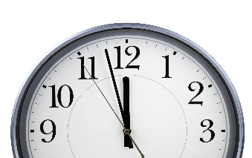





How Much?
How much Quality is enough?
$$Time$$
$$Energy$$
$$Money$$
Notes:
For example, in the health care industry, aiming for zero complications in cardiac surgery might sound good; however, if it comes at the cost of turning down high-risk patients, is society being served in the best way? Or how much time, energy, and money should go into delivering vaccines or preventing complications? These are questions that often do not have clear answers.
Many companies spend significant time, effort, and expense on systems, training, and organizational changes to improve the quality and performance of their processes. They believe that it is important to be able to gauge current levels of performance so that any process gaps can be determined.

Slide 7

Gauge the Gap
Gap: Dissatisfied Customers & additional costs for the firm

Slide 8


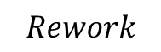
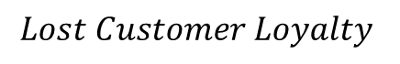
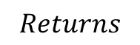

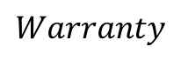

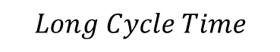
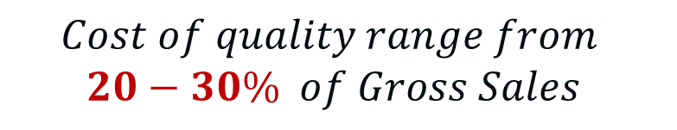
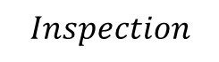

Cost of Quality
$$Inspection$$
$$Rework$$
$$Warranty$$
$$Returns$$
$$Lost Sales$$
$$Late delivery$$
$$Long Cycle Time$$
$$Lost Customer Loyalty$$
$$Cost of quality range from$$
$$20−30\% of Gross Sales$$
$$Long set−up$$
Notes:
Most experts estimate that the costs of quality range from 20 to 30 percent of gross sales. These costs can be broken down into four major categories: (1) prevention, (2) appraisal, (3) internal failure, and (4) external failure. The American Society for Quality, also commonly known as ASQ (http://asq.org/learn-about-quality/cost-of-quality/overview/overview.html), provides several examples of these four types of costs. In addition, there is a fifth category of costs associated with unethical behavior in making quality decisions, and which can be significantly higher than all the other four costs combined.

Slide 9
Costs of Quality
Preventive
Costs
Appraisal
Costs
5
Internal
Failure
Costs
Ethical Failure
Costs
External Failure
Costs
Notes:
Ethical Failure costs can be significantly higher than all the other four costs combined.

Slide 10
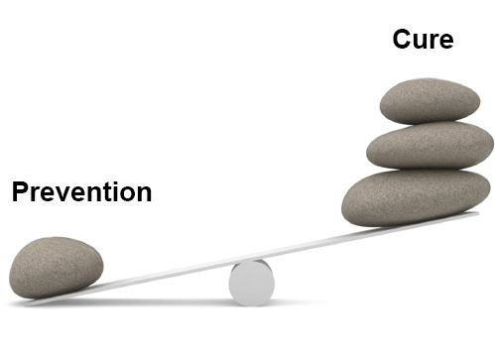
Costs of Quality
Prevention costs
Costs associated with preventing defects before they happen
product or service requirements (specifications)
quality planning (Operations, Production, Inspection)
Quality assurance (Maintenance)
Training (Development , Preparation, Maintenance)
Notes:
They include the costs of redesigning the process to remove the causes of poor performance, redesigning the service or product to make it simpler to produce, training employees in the methods of continuous improvement, and working with suppliers to increase the quality of purchased items or contracted services.
(1) product or service requirements, which involve establishment of specifications for incoming materials, processes, finished products, and services; (2) quality planning, which involves creation of plans for quality, reliability, operations, production, and inspection; (3) quality assurance, which involves creation and maintenance of a well-defined quality system; and (4) training that is focused on the development, preparation, and maintenance of quality-related programs.

Slide 11

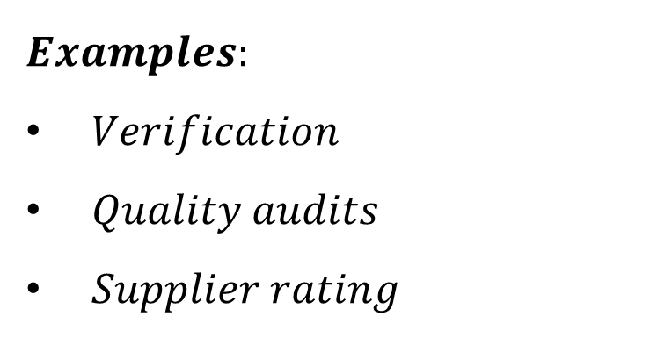

Costs of Quality
2. Appraisal costs
Costs incurred when the firm assesses the performance level of its processes
$$Preventive Costs$$
$$Appraisal Costs$$
$$Examples:$$
$Verification$
$Quality audits$
$Supplier rating$
Notes:
As the costs of prevention increase and performance improves, appraisal costs decrease because fewer resources are needed for quality inspections and the subsequent search for causes of any problems that are detected.
Some examples of appraisal costs include (1) verification, which involves checking of incoming materials, process setups, and products against agreed upon specifications; (2) quality audits aimed at confirming that the quality system is functioning cor- rectly; and (3) supplier rating, which is the assessment and approval of suppliers of products and services.

Slide 12

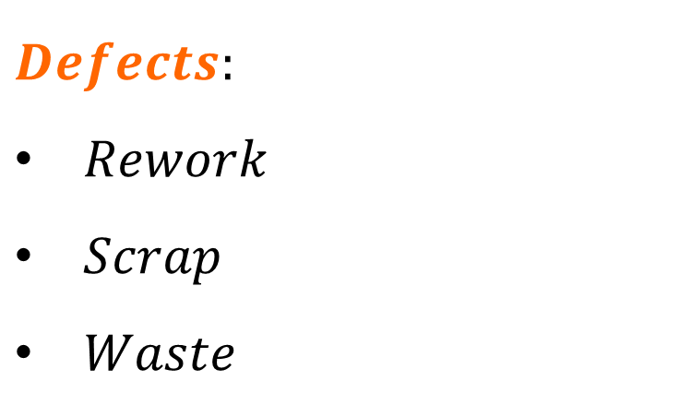
Costs of Quality
3. Internal Failure costs
Costs resulting from defects that are discovered during the production of a service or product.
$$Defects:$$
$Rework$
$Scrap$
$Waste$
Notes:
Defects fall into three main categories: (1) rework or rectification, which is incurred if some aspect of a service must be performed again or if a defective item must be rerouted to some previous operation(s) to correct the defect; (2) scrap, which is incurred if a defective item is unfit for further processing and cannot be repaired, used, or sold; and (3) waste, which involves performance of unnecessary work

Slide 13
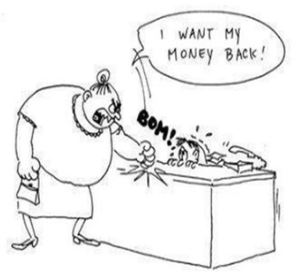
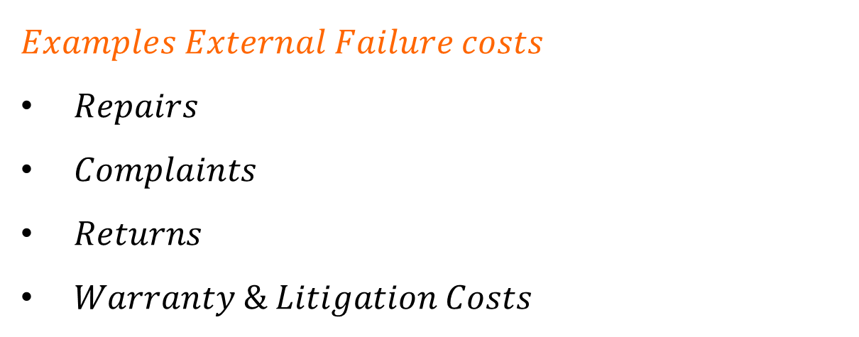
Costs of Quality
4. External Failure costs (Worst)
Costs that arise when a defect is discovered after the customer receives the service or product
$$Examples External Failure costs$$
$Repairs$
$Complaints$
$Returns$
$Warranty \& Litigation Costs$
Notes:
Dissatisfied customers talk about bad service or products to their friends, who in turn tell others. If the problem is bad enough, consumer protection groups may even alert the media. The potential impact on future profits is difficult to assess, but without doubt external failure costs erode market share and profits. Encountering defects and correcting them after the product is in the customer’s hands is costly.
Examples of external failure costs include costs that are associated with (1) repairs and servicing of both returned products and those actually being used by customers; (2) complaints, which involve all costs and work associated with handling and servicing customers’ complaints; (3) returns, which involves transportation of rejected or recalled products; and (4) warranty service and litigation costs,

Slide 14

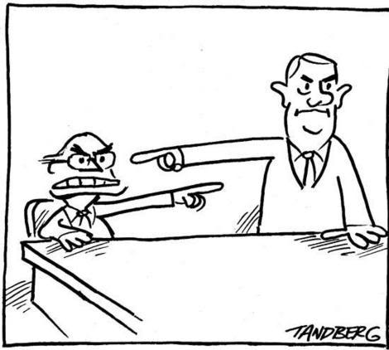
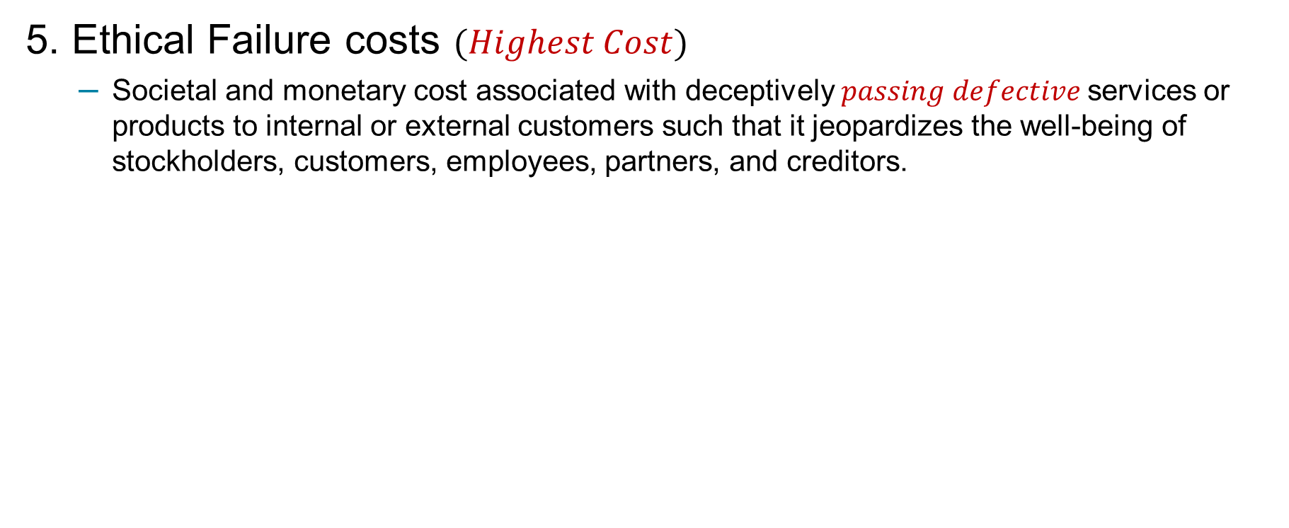
Costs of Quality
5. Ethical Failure costs $(Highest Cost)$
Societal and monetary cost associated with deceptively $passing defective$services or products to internal or external customers such that it jeopardizes the well-being of stockholders, customers, employees, partners, and creditors.
Notes:
ethical costs arise from internal or external failures. The main difference is that somebody tries to “cover them up” and knowingly passes the defects along to the customer knowing that they can do harm. What makes the nature of ethical failure costs different from internal failure or external failure costs already mentioned is the punitive costs of litigation once the ethical lapses are discovered, the extraordinary magnitude of the fines and penalties, the loss of goodwill that can literally damage the firm for a long time, and the hidden costs of employee morale and attitude.
Ethical costs are tied to deception and shifting the blame to other partners in the supply chain and go beyond the internal or external failure costs associated with fixing the quality problems in an organization.
Deceptive business practices are a source of major concern for service or product quality. Deceptive business practice involves three elements: (1) The conduct of the provider is intentional and motivated by a desire to exploit the customer; (2) the provider conceals the truth based upon what is actually known to the provider; and (3) the transaction is intended to generate a disproportionate economic benefit to the provider at the expense of the customer.

Slide 15


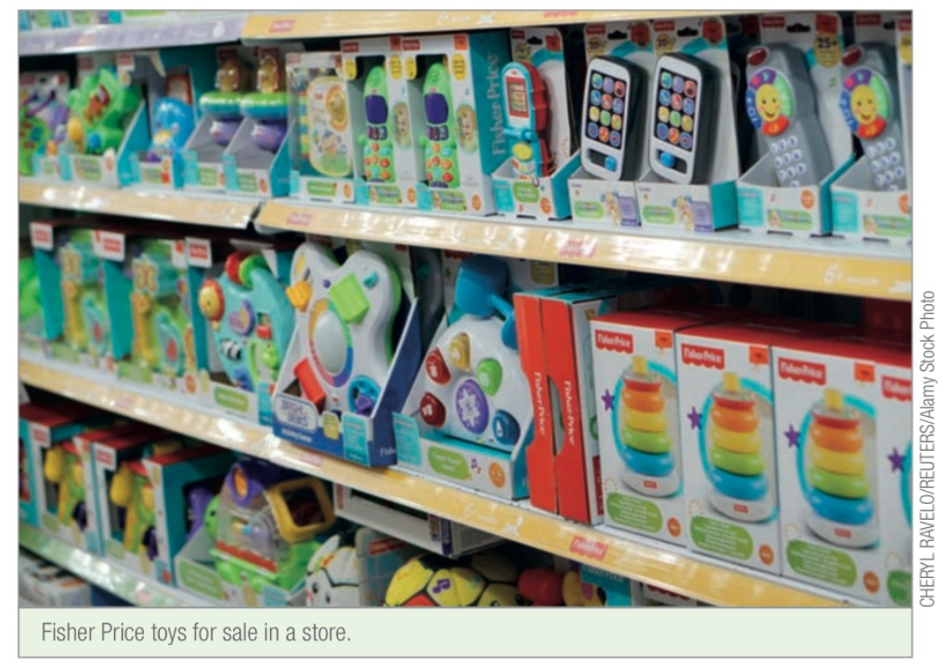


Costs of Quality
5. Ethical Failure costs
(Recall multiple products in 2007)
Notes:
brands like Fisher Price, Barbie Dolls, and Hot Wheels, among others—had to issue multiple product recalls in 2007 due to the presence of cheaper but toxic lead paint in its toys. Problems also existed with loosely attached small magnets in its toys, which if swallowed could cause injuries to children. Despite exerting downward pressures on costs, Mattel initially denied knowledge and responsibility for the use of lead paint, and instead placed the blame on the suppliers to its manufacturing plants in China. But later on, after stockholder lawsuits claiming the withholding of timely information and misleading financial statements, and also government and media pressure, Mattel instituted stringent inspection and quality programs to prevent the recurrence of such incidents. As a result, Mattel has significantly repaired its corporate image over time.

Slide 16


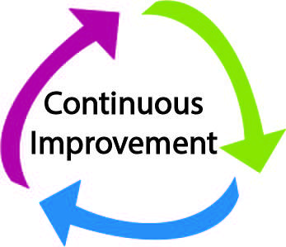

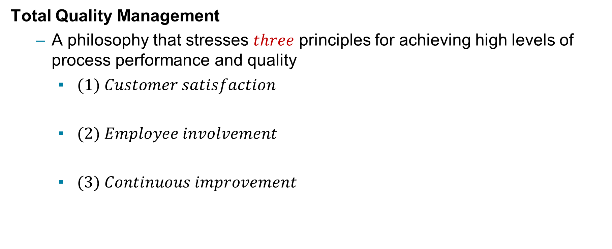
Total Quality Management and 6 Sigma
Total Quality Management
A philosophy that stresses $three$ principles for achieving high levels of process performance and quality
$(1) Customer satisfaction$
$(2) Employee involvement$
$(3) Continuous improvement$

Slide 17
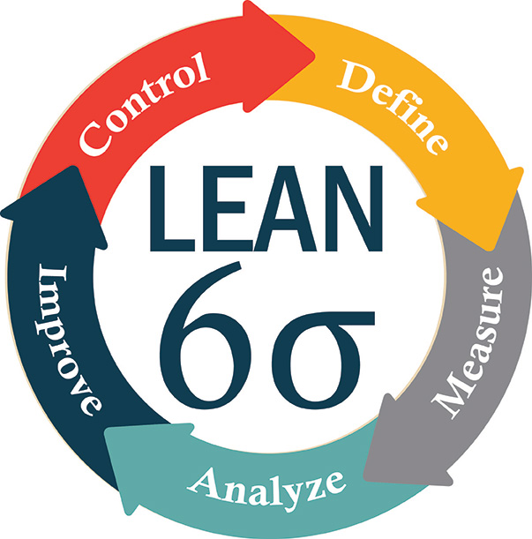
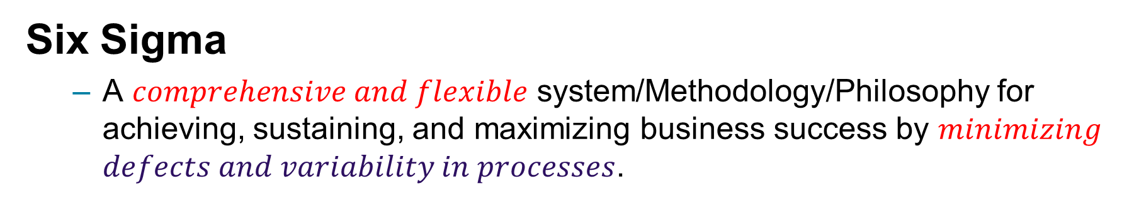
Total Quality Management and Six Sigma
Six Sigma
A $comprehensive and flexible$ system/Methodology/Philosophy for achieving, sustaining, and maximizing business success by $minimizing$ $defects and variability in processes$.

Slide 18
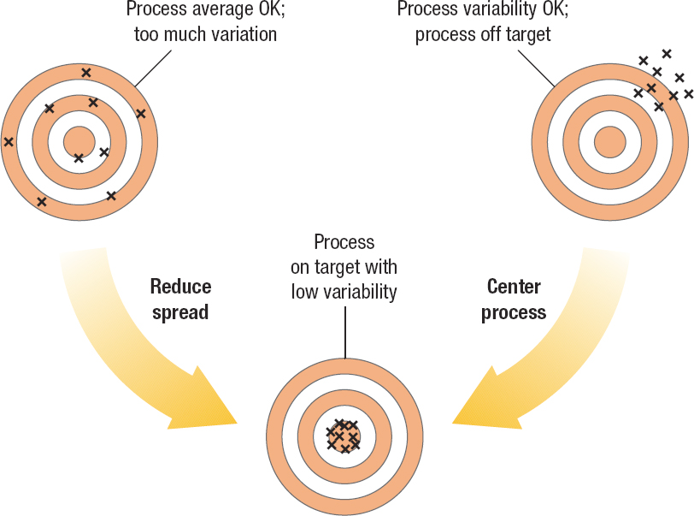
Six Sigma
Figure 3.3 Six Sigma Approach Focuses on Reducing Spread and Centering the Process
Notes:
It relies heavily on the principles of TQM, and is a comprehensive and flexible system for achieving, sustaining, and maximizing business success by minimizing defects and variability in processes.
It is driven by a close understanding of customer needs; the disciplined use of facts, data, and statistical analysis;
Figure 3.3 shows how Six Sigma focuses on reducing variation in processes as well as centering processes on their target measures of performance.

Slide 19
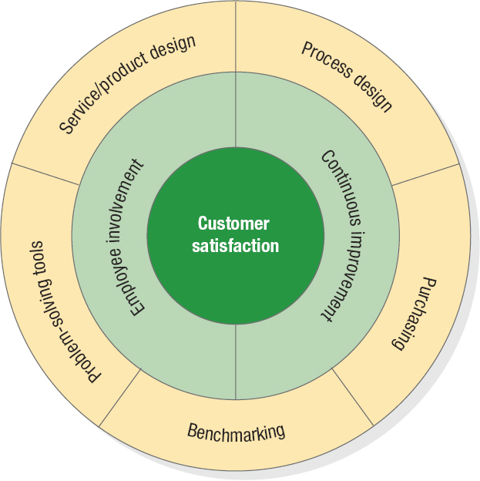
Total Quality Management
Figure 3.1 T Q M Wheel
Notes:
Figure 3.1 indicates, TQM also involves a number of other important elements. We have covered tools and process analysis techniques useful for process problem solving, redesign, and improvement in Chapter 2 “Process Strategy and Analysis”. Service or product design and purchasing are covered later in this text. Here, we just focus on the three main principles of TQM, which must always be guided and supported by management commitment and leadership in creating a quality-driven organization.

Slide 20
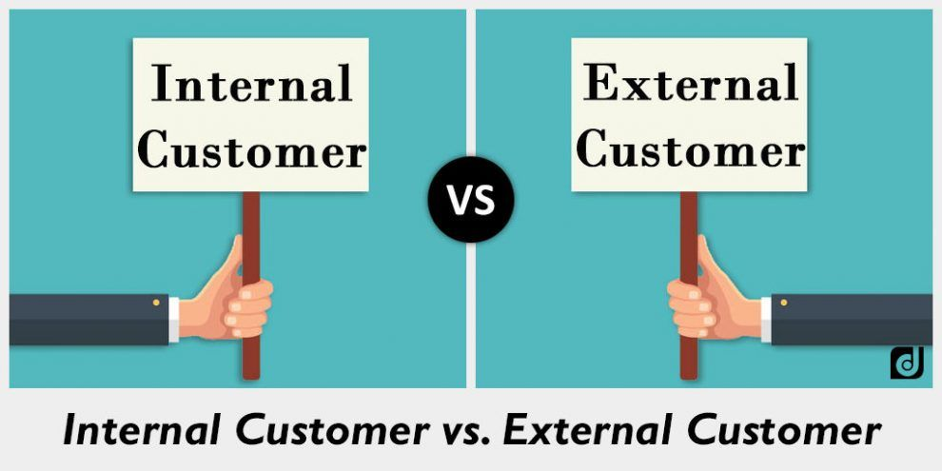
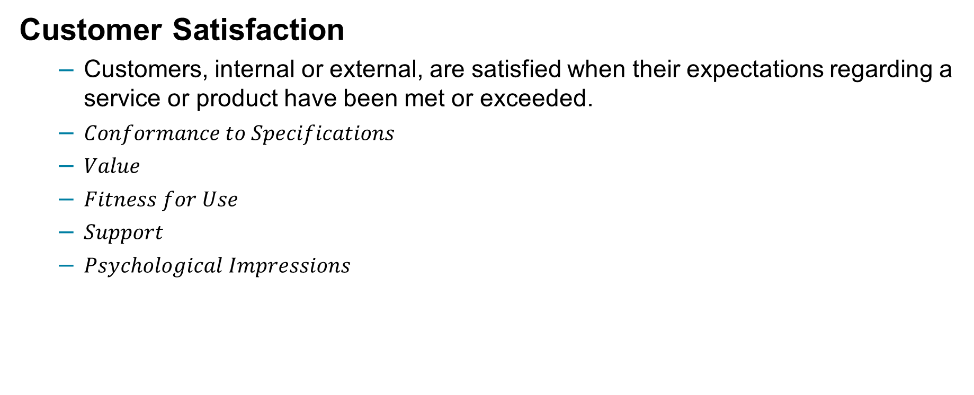
Total Quality Management
Customer Satisfaction
Customers, internal or external, are satisfied when their expectations regarding a service or product have been met or exceeded.
$Conformance to Specifications$
$Value$
$Fitness for Use$
$Support$
$Psychological Impressions$
$$Attaining quality in all areas of a business is a difficult task$$
$$Consumers continuously change their perceptions of quality$$
Notes:
Often, customers use the general term quality to describe their level of satisfaction with a service or product. Quality has multiple dimensions in the mind of the customer, which cut across the nine competitive priorities we introduced in Chapter 1, “Using Operations to Create Value.” One or more of the following five definitions apply at any one time.
▪▪Conformance to Specifications. Although customers evaluate the service or product they receive, it is the processes that produced the service or product that are really being judged. In this case, a process failure would be the process’s inability to meet certain advertised or implied performance standards. Conformance to specifications may relate to consistent quality, on-time delivery, or delivery speed.
▪▪Value. Another way customers define quality is through value, or how well the service or describe their general satisfaction
product serves its intended purpose at a price customers are willing to pay.
The service or product development process plays a role here, as do the firm’s competitive priorities relating to top-quality versus low-cost operations. The two factors must be balanced to produce value for the customer. How much value a service or product has in the mind of the customer depends on the customer’s expectations before purchasing it.
▪▪ Fitness for Use. When assessing how well a service or product performs its intended purpose, the customer may consider the convenience of a service, the mechanical features of a product, or other aspects such as appearance, style, durability, reliability, craftsmanship, and serviceability. For example, you may define the quality of the entertainment center you purchased on the basis of how easy it was to assemble and its appearance and styling.
▪▪ Support. Often the service or product support provided by the company is as important to customers as the quality of the service or product itself. Customers get upset with a company if its financial statements are incorrect, responses to its warranty claims are delayed, its advertising is misleading, or its employees are not helpful when problems are incurred. Good support once the sale has been made can reduce the consequences of quality failures.
▪▪ Psychological Impressions. People often evaluate the quality of a service or product on the basis of psychological impressions: atmosphere, image, or aesthetics. In the provision of services where the customer is in close contact with the provider, the appearance and actions of the provider are especially important. Nicely dressed, courteous, friendly, and sympathetic employees can affect the customer’s perception of service quality.

Slide 21

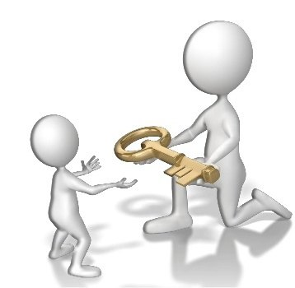
Total Quality Management
Employee Involvement
Cultural Change
Quality at the Source
A philosophy whereby defects are caught and corrected where they were created
Teams
Employee Empowerment
Problem-solving teams
Special-purpose teams
Notes:
It is helpful to point out to employees that each employee also has one or more internal customers—employees in the firm who rely on the output of other employees. All employees must do a good job of serving their internal customers if external customers ultimately are to be satisfied. They will be satisfied only if each internal customer demands value be added that the external customer will recognize and pay for. The notion of internal customers applies to all parts of a firm and enhances cross-functional coordination. For example, accounting must prepare accurate and timely reports for management, and purchasing must provide high-quality materials on time for operations.
In TQM, everyone in the organization must share the view that quality control is an end in itself. Errors or defects should be caught and corrected at the source, not passed along to an internal or external customer. For example, a consulting team should make sure its billable hours are correct before submitting them to the accounting department. This philosophy is called quality at the source. In addition, firms should avoid trying to “inspect quality into the product” by using inspectors to weed out unsatisfactory services or defective products after all operations have been performed. By contrast, in some manufacturing firms, workers have the authority to stop a production line if they spot quality problems.

Slide 22
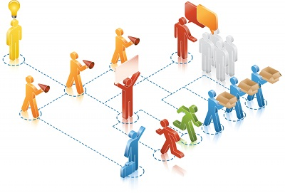

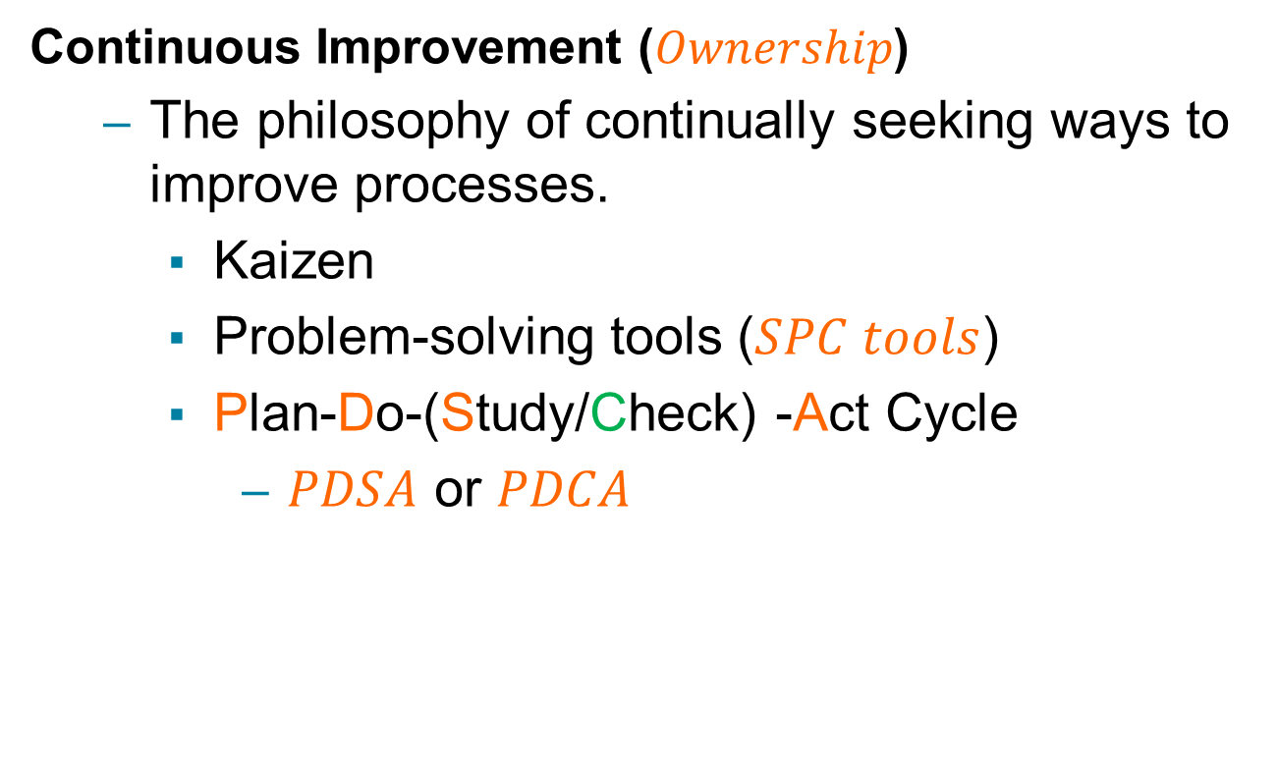
Total Quality Management
Continuous Improvement ($Ownership$)
The philosophy of continually seeking ways to improve processes.
Kaizen
Problem-solving tools ($SPC tools$)
Plan-Do-(Study/Check) -Act Cycle
$PDSA$ or $PDCA$
Notes:
Continuous improvement involves identifying benchmarks of excellent practice and instilling a sense of employee ownership in the process. The focus of continuous improvement projects is to reduce waste, such as reducing the length of time required to process requests for loans at a bank, the amount of scrap generated at a milling machine, or the number of employee injuries at a construction site.
The basis of the continuous improvement philosophy is the belief that virtually any aspect of a process can be improved and that the people most closely associated with a process are in the best position to identify the changes that should be made. The idea is not to wait until a massive problem occurs before acting.
Employees should be given problem-solving tools, such as the statistical process control (SPC) methods and a sense of ownership of the process to be improved.
A sense of operator ownership emerges when employees feel a responsibility for the processes and methods they use and take pride in the quality of the service or product they produce. It comes from participation on work teams and in problem-solving activities, which instill in employees a feeling that they have some control over their workplace and tasks.

Slide 23
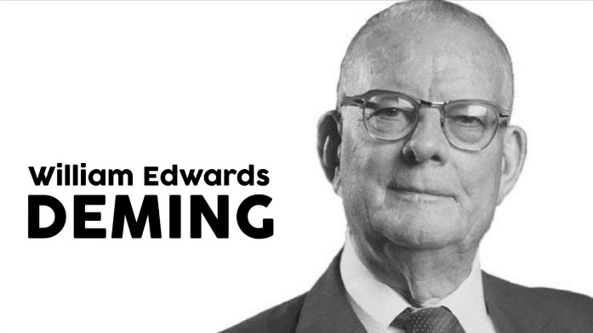
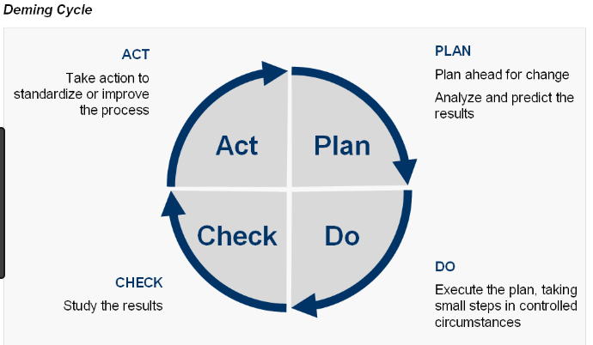
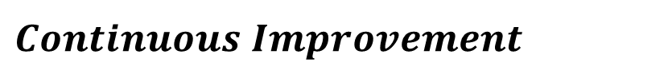
Total Quality Management
$$Continuous Improvement$$
Notes:
1. Plan. The team selects a process (an activity, method, machine, or policy) that needs improvement. The team then documents the selected process, usually by analyzing related data; sets qualitative goals for improvement; and discusses various ways to achieve the goals. After assessing the benefits and costs of the alternatives, the team develops a plan with quantifiable measures for improvement.
2. Do. The team implements the plan and monitors progress. Data are collected continuously to measure the improvements in the process. Any changes in the process are documented, and further revisions are made as needed.
3. Study or check. The team analyzes the data collected during the do step to find out how closely the results correspond to the goals set in the plan step. If major short- comings exist, the team reevaluates the plan or stops the project.
4. Act. If the results are successful, the team documents the revised process so that it becomes the standard procedure for all who may use it. The team may then instruct other employees in the use of the revised process.

Slide 24
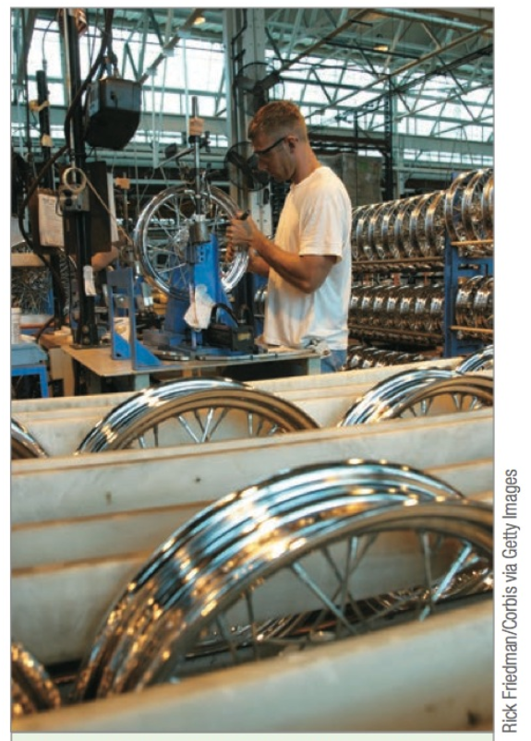
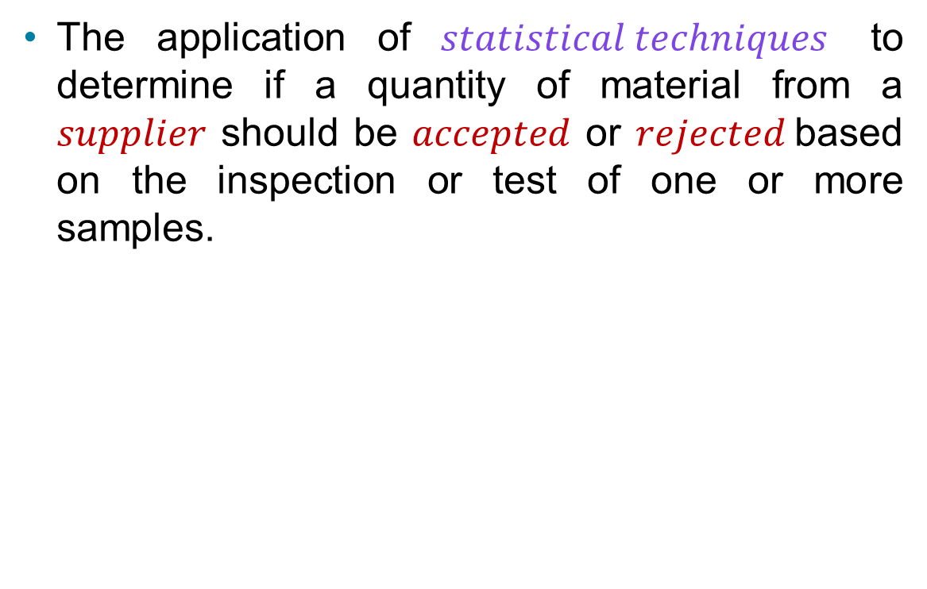
Acceptance Sampling
The application of $statistical techniques$ to determine if a quantity of material from a $supplier$ should be $accepted$ or $rejected$based on the inspection or test of one or more samples.

Slide 25
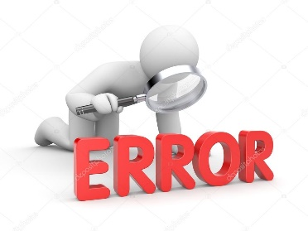
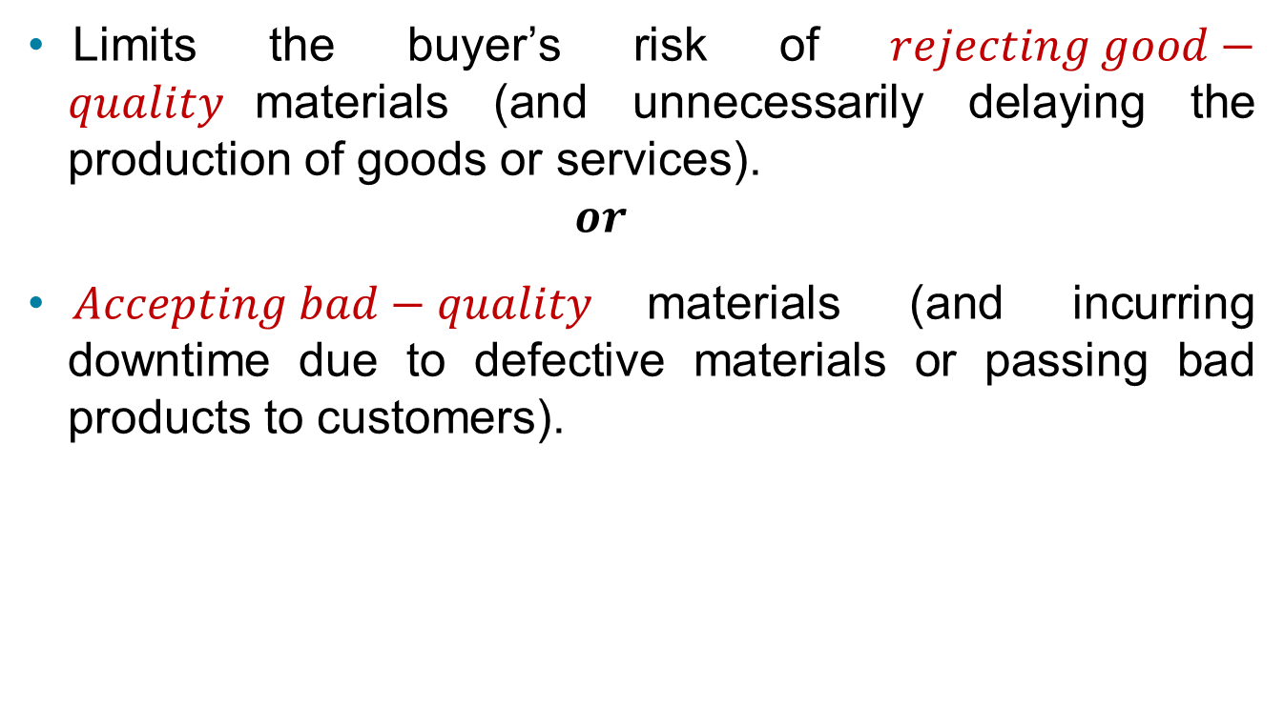

Acceptance Sampling
Limits the buyer’s risk of $rejecting good−quality$materials (and unnecessarily delaying the production of goods or services).
$$or$$
$Accepting bad−quality$materials (and incurring downtime due to defective materials or passing bad products to customers).
$$Which one of these 2 error$$
$$is more sever?$$

Slide 26
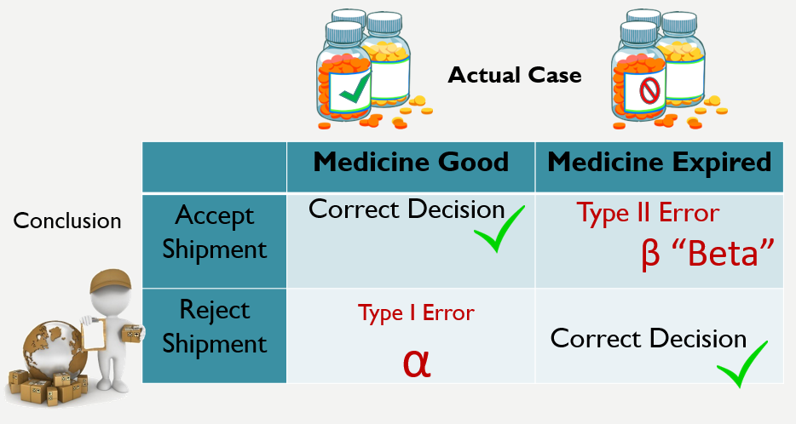
Type I & Type II errors

Slide 27
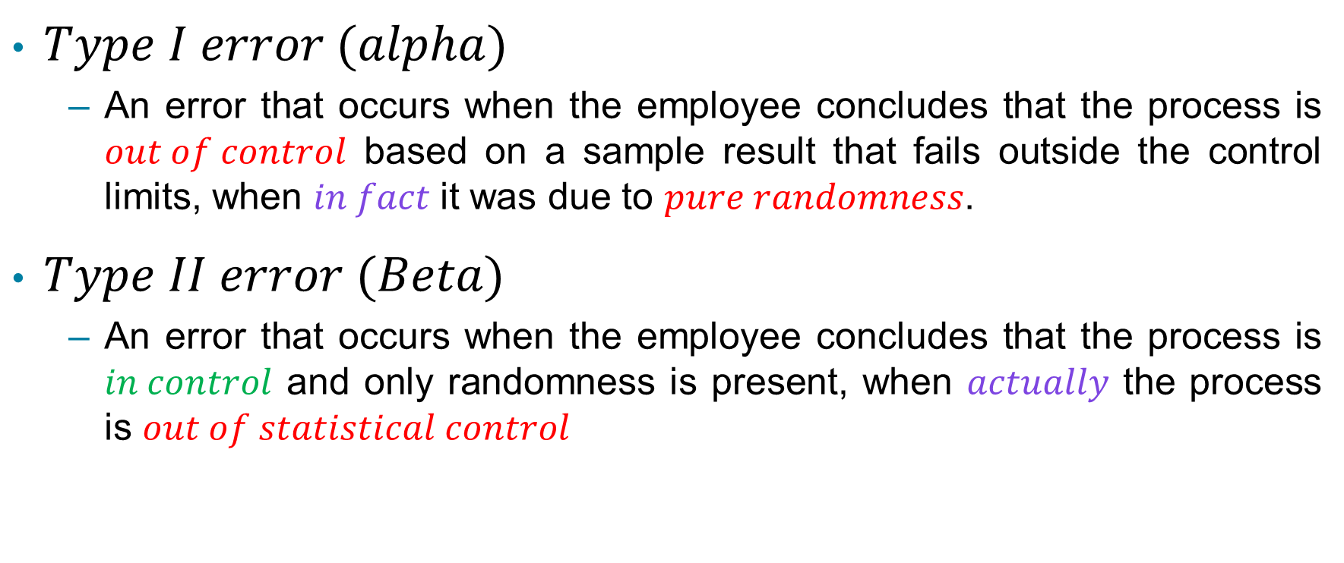
Type I & Type II errors
$Type I error (alpha)$
An error that occurs when the employee concludes that the process is $out of control$ based on a sample result that fails outside the control limits, when $in fact$it was due to $pure randomness$.
$Type II error (Beta)$
An error that occurs when the employee concludes that the process is $in control$ and only randomness is present, when $actually$ the process is $out of statistical control$

Slide 28
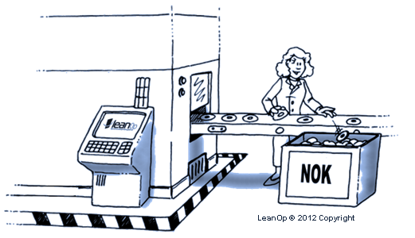
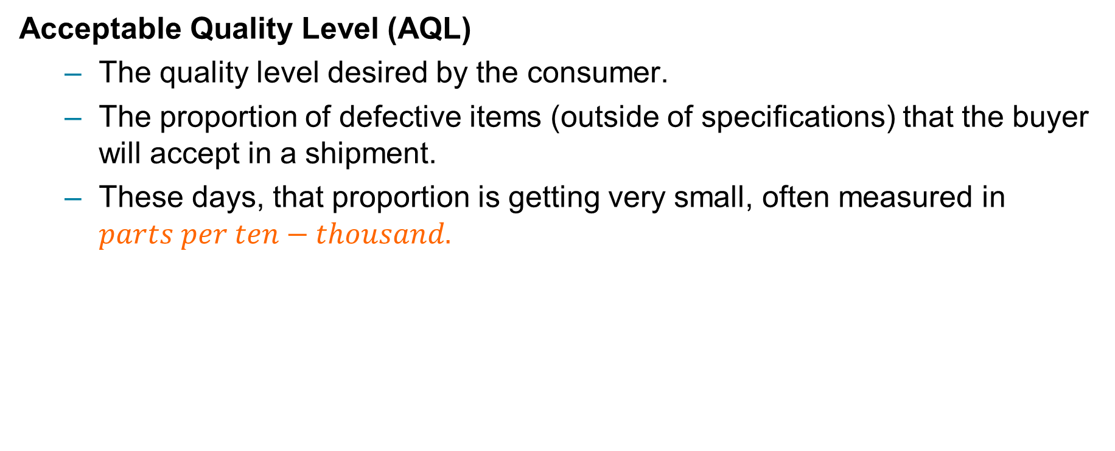
Acceptance Sampling
Acceptable Quality Level (AQL)
The quality level desired by the consumer.
The proportion of defective items (outside of specifications) that the buyer will accept in a shipment.
These days, that proportion is getting very small, often measured in $parts per ten−thousand.$

Slide 29


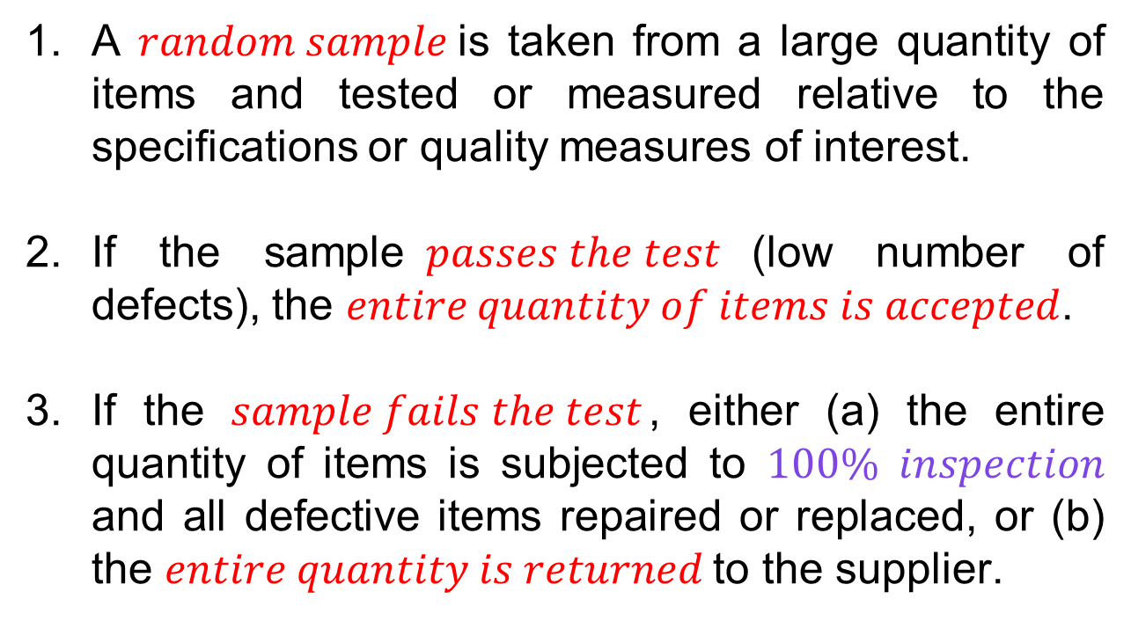
Acceptance Sampling Process
A $random sample$is taken from a large quantity of items and tested or measured relative to the specifications or quality measures of interest.
If the sample$passes the test$(low number of defects), the $entire quantity of items is accepted$.
If the $sample fails the test$, either (a) the entire quantity of items is subjected to $100\% inspection$ and all defective items repaired or replaced, or (b) the $entire quantity is returned$to the supplier.

Slide 30
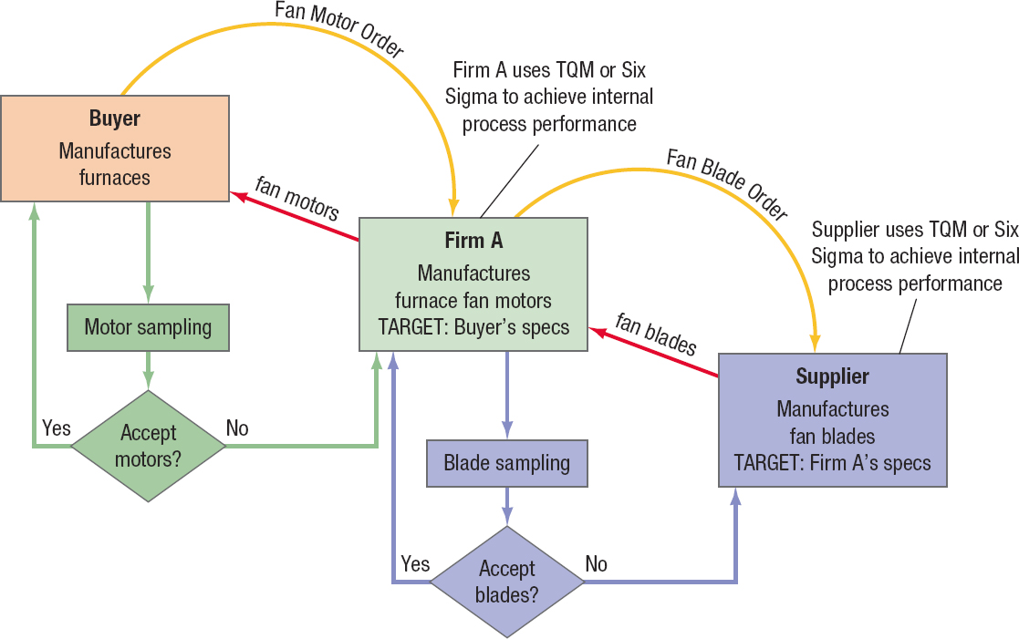
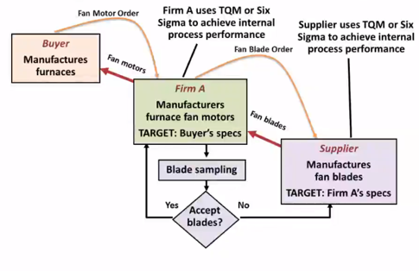
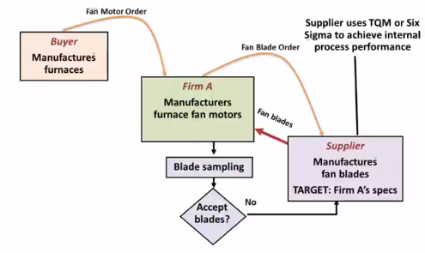
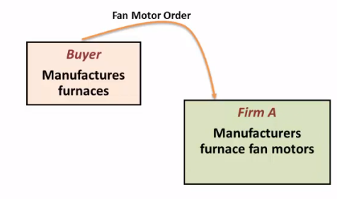
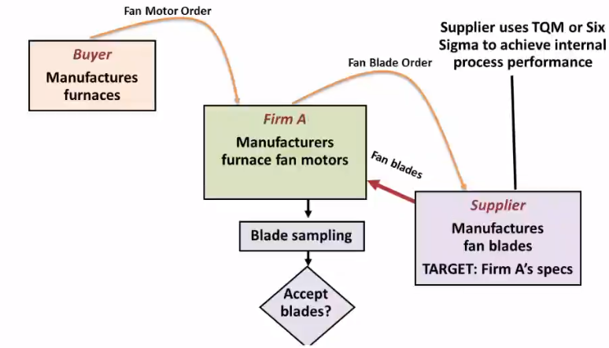
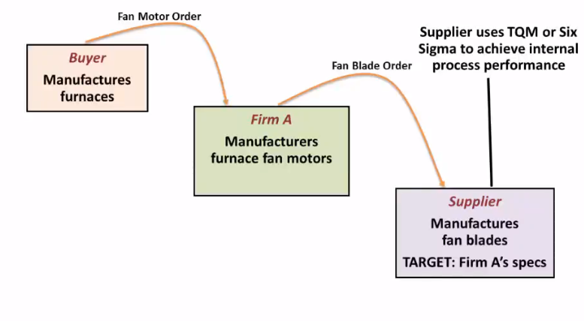
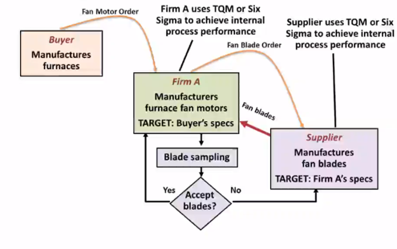
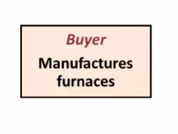
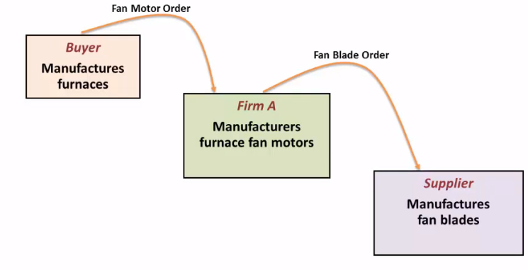
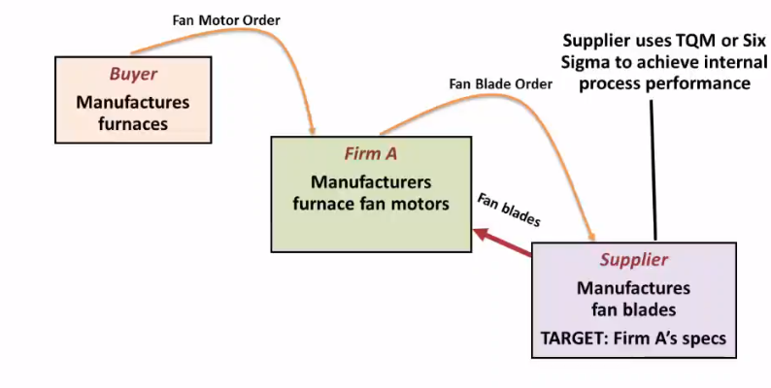
Figure 3.4 Interface of Acceptance Sampling and Process Performance Approaches in a Supply Chain

Slide 31

Statistical Process Control (S P C)
Notes:
Regardless of whether a firm is producing a service or a product, it is important to ensure that the firm’s processes are providing the quality that customers want. A key element of TQM or Six Sigma is building the capability to monitor the performance of processes so that corrective action can be initiated in a timely fashion.

Slide 32





Evaluating the Performance of the process
Requires a Variety of Data Gathering Approaches

Slide 33




Statistical Process Control (S P C)
The application of statistical techniques to determine whether a process is delivering what the customer wants.
Control Chart
Notes:
Here, we focus on the powerful statistical tools that can be used to monitor and manage repetitive processes.
In SPC, tools called “control charts” are used primarily to detect defective services or products or to indicate that the process has changed and that services or products will deviate from their design specifications, unless something is done to correct the situation. SPC can also be used to inform management of improved process changes.

Slide 34
Examples
A decrease in the average number of complaints per day at a hotel.
A sudden increase in the proportion of defective gear boxes.
An increase in the time to process a mortgage application.
A decline in the number of scrapped units at a milling machine.
An increase in the number of claimants receiving late payment from an insurance company.

Slide 35
Variation of Output
No two services or products are exactly alike because the processes used to produce them contain many sources of variation, even if the processes are working as intended.
Notes:
it is important to minimize the variation in outputs because frequently variation is what the customer sees and feels.

Slide 36




Variation of Output: Performance Measurement
Variables - Service or product characteristics that can be measured.
Attributes - Service or product characteristics that can be quickly counted for acceptable performance. Make a simple “yes or no” decision about whether a service or product meets the specifications.
Notes:
The advantage of using performance variables is that if a service or product misses its performance specifications, the inspector knows by how much. The disadvantage is that such measurements typically involve special equipment, employee skills, exacting procedures, and time and effort.
Attributes often are used when performance specifications are complex and measurement of variables is difficult or costly. Some examples of attributes that can be counted are the number of insurance forms containing errors that cause underpayments or overpayments, the proportion of airline flights arriving within 15 minutes of scheduled times, and the number of stove-top assemblies with spotted paint.
The advantage of counting attributes is that less effort and fewer resources are needed than for measuring variables. The disadvantage is that, even though attribute counts can reveal that process performance has changed, they do not indicate by how much.

Slide 37



Variation of Output: Sampling
Complete Inspection
Inspect each service or product at each stage of the process for quality.
Sampling plan
Sample Size
Time between successive samples
Decision rules that determine when action should be taken
https://www.surveysystem.com/sscalc.htm

Slide 38




Sampling Methods
Cluster
Systematic
Convenience
Stratified
Judgement

Slide 39




Variation of Output: Sampling Distribution
$$Measures of Location and Variation$$

Slide 40

Variation of Output: Causes
Categories of Variation in Output
Common cause - The purely random, unidentifiable sources of variation that are unavoidable with the current process
Assignable cause - Any variation-causing factors that can be identified and eliminated
Notes:
Assignable causes of variation include an employee needing training or a machine needing repair.

Slide 41

Control Charts
Control Chart
Time-ordered diagram that is used to determine whether observed variations are abnormal.
Controls chart have a nominal value or center line, Upper Control Limit (U C L), and Lower Control Limit (L C L).
Can be the process’s historic average or
a target that we would like to achieve,
Figure 3.7 How Control Limits Relate to the Sampling Distribution: Observations from Three Samples

Slide 42

Control Charts
Figure 3.8 Control chart examples
Notes:
A statistic that falls outside the control limits indicates that the process is exhibiting assignable causes of variation.
Observations falling outside the control limits do not always mean poor quality.
Sometimes, problems with a process can be detected even though the control limits have not been exceeded. Figure 3.8 contains four examples of control charts.

Slide 43

Control Charts
(a) Normal – No action
Figure 3.8 Control Chart Examples

Slide 44

Control Charts
(b) Run – Take action
Notes:
shows a pattern called a run or a sequence of observations with a certain characteristic. A typical rule is to take remedial action when five or more observations show a downward or upward trend, even if the points have not yet exceeded the control limits.

Slide 45

Control Charts
(c) Sudden change – Monitor

Slide 46

Control Charts
(d) Exceeds control limits – Take action

Slide 47





Control Charts
$$Observations falling$$
$$outside the control$$
$$limits do not$$
$$always mean$$
$$poor quality.$$
$$Example$$
Figure 3.8 Control chart examples
Notes:
Figure 3.7 the assignable cause may be a new billing process introduced to reduce the number of incorrect bills sent to customers. If the proportion of incor- rect bills—that is, the performance measure from a sample of bills—falls below the LCL of the control chart, the new procedure likely changed the billing process for the better, and a new control chart should be constructed.

Slide 48


Control Charts
https://www.spcforexcel.com/knowledge/control-chart-basics/control-chart-rules-interpretation

Slide 49
Control Charts
Steps for using a control chart
Take a random sample from the process and calculate a variable or attribute performance measure.
If a statistic falls outside the chart’s control limits or exhibits unusual behavior, look for an assignable cause.
Eliminate the cause if it degrades performance; incorporate the cause if it improves performance. Reconstruct the control chart with new data.
Repeat the procedure periodically.

Slide 50





Control Charts
$$Control$$
$$Charts$$
$$Variables$$
$$Attributes$$

Slide 51

Control Charts

Slide 52




Types of Control Charts
Control Charts for Variables
$R−Chart$ – Measures the variability of the process
$\overline{x}−Chart$ – Measures whether the process is generating output, on average, consistent with a target value
Control Charts for Attributes
$p−Chart$ – Measures the proportion of $defective$ services or products generated by the process
$c−Chart$ – Measures the number of $defects$ when more than one defect can be present in a service or product
$$Range$$
$$Proportion$$
$$Count$$

Slide 53
Types of Control Charts: R-Chart
Used to monitor the mean and the variability of the process distribution
where
= average of several past R values and the central line of the control chart
D₃, D₄ = constants that provide three standard deviation (three-sigma) limits for the given sample size
Notes:
R-Chart A range chart, or R-chart, is used to monitor process variability. To calculate the range of a set of sample data, the analyst subtracts the smallest from the largest measurement in each sample. If any of the ranges fall outside the control limits, the process variability is not in control.

Slide 54

Types of Control Charts: R-Chart
The spread between the control limits narrows as the sample size increases.
Notes:
Notice that the values for D3 and D4 shown in Table 3.1 change as a function of the sample size. Notice, too, that the spread between the control limits narrows as the sample size increases. This change is a consequence of having more information on which to base an estimate for the process range.

Slide 55


Types of Control Charts: $\overline{x}$-Chart
Used to see whether the process is generating output, on average, consistent with a target value set by Management.
$$where$$
= central line of the chart, which can be either the average of past sample means or a target value set for the process
A₂ = constant to provide three-sigma limits for the sample mean
X bar Chart depends on R bar, so if the variability is high, it needs to be tackled before developing X bar chart.
Notes:
A target value is useful when a process is completely redesigned and past performance is no longer relevant.

Slide 56

How to Compute Control Charts
Steps to Compute Control Charts:
Collect data.
Compute the range.
Use Table 3.1 to determine R-Chart control limits.
Plot the sample ranges. If all are in control, proceed to step 5. Otherwise, find the assignable causes, correct them, and return to step 1.
Calculate $\overline{x}$for each sample and determine the central line of the chart, $\overline{\overset{̿}{x}}$

Slide 57

How to Compute Control Charts
Use Table 3.1 to determine the parameters for U C L and L C L for $\overline{x}$chart
Plot the sample means. If all are in control, the process is in statistical control. Continue to take samples and monitor the process. If any are out of control, find the assignable causes, address them, and return to step 1. If no assignable causes are found after a diligent search, assume the out-of-control points represent common causes of variation and continue to monitor the process.

Slide 58
Example 1 – Page 111, 112 (Book)
The management of West Allis Industries is concerned about the production of a special metal screw used by several of the company’s largest customers. The diameter of the screw is critical to the customers. Data from five samples appear in the accompanying table. The sample size is 4. Is the process in statistical control?
Sample Number | Observation 1 | Observation 2 | Observation 3 | Observation 4 | R | x-bar
1 | 0.5014 | 0.5022 | 0.5009 | 0.5027 | 0.0018 | 0.5018
2 | 0.5021 | 0.5041 | 0.5024 | 0.5020 | 0.0021 | 0.5027
3 | 0.5018 | 0.5026 | 0.5035 | 0.5023 | 0.0017 | 0.5026
4 | 0.5008 | 0.5034 | 0.5024 | 0.5015 | 0.0026 | 0.5020
5 | 0.5041 | 0.5056 | 0.5034 | 0.5047 | 0.0022 | 0.5045
 |  |  |  | Average | 0.0021 | 0.5027

Slide 60

Example 1 (Cont’d)
Compute the range for each sample and the control limits
$$UCL_{R} = D_{4}\overline{R} = 2.282\left(0.0021\right)= 0.00479 in.$$
$$LCL_{R}= D_{3}\overline{R}= 0(0.0021) = 0 in.$$

Slide 61

Example 1 (Cont’d)
Figure 3.9 Range Chart
Process variability is in Statistical Control.

Slide 63

Example 1 (Cont’d)
Compute the mean for each sample and the control limits.
$$UCL_{\overline{x}}= \overset{̿}{x} + A_{2}\overline{R}= 0.5027 + 0.729(0.0021) = 0.5042 in.$$ $$LCL_{\overline{x}}= \overset{̿}{x}−A_{2}\overline{R}= 0.5027 − 0.729(0.0021) = 0.5012 in.$$

Slide 64


Example 1 (Cont’d)
Process average is NOT in statistical control.

Slide 65


Example 1 (Cont’d)
Sample Number | Observation 1 | Observation 2 | Observation 3 | Observation 4 | R | x-bar
1 | 0.5014 | 0.5022 | 0.5009 | 0.5027 | 0.0018 | 0.5018
2 | 0.5021 | 0.5041 | 0.5024 | 0.5020 | 0.0021 | 0.5027
3 | 0.5018 | 0.5026 | 0.5035 | 0.5023 | 0.0017 | 0.5026
4 | 0.5008 | 0.5034 | 0.5024 | 0.5015 | 0.0026 | 0.5020
5 | 0.5041 | 0.5056 | 0.5034 | 0.5047 | 0.0022 | 0.5045
Blank | Blank | Blank | Blank | Average | 0.0021 | 0.5027

Slide 66
Another Method : X bar Chart
If the standard deviation of the process distribution is known, another form may be used of the
where
σ = standard deviation of the process distribution
n = sample size
z = normal deviate number

Slide 67


Example 2 – Page 113
For Sunny Dale Bank, the time required to serve customers at the drive-by window is an important quality factor in competing with other banks in the city.
Mean time to process a customer at the peak demand period is 5 minutes
Standard deviation is 1.5 minutes
Sample size is six customers
Design an $\overline{x}$-chart that has type I error of 5 percent
After several weeks of sampling, two successive samples came in at 3.70 and 3.68 minutes, respectively. Is the customer service process in statistical control?

Slide 68

Example 2 – Page 113
s = 1.5 minutes
n = 6 customers
z = 1.96
$$The control limits are:$$
$$The new process is an improvement.$$

Slide 69


Exercise – Individual – $Q−01$

Slide 70

Exercise – Individual – $Q−02$

Slide 71


Control Charts for Attributes: P chart
$\overline{p}−Charts$are used for controlling the $proportion$of defective services or products generated by the process.
$$The standard deviation is$$

Slide 72

Example 3
Hometown Bank is concerned about the number of wrong customer account numbers recorded.
Each week a random sample of 2,500 deposits is taken and the number of incorrect account numbers is recorded.
Using three-sigma control limits, is the booking process out of statistical control?
Calculate the sample proportion defective and plot
each sample proportion defective on the chart.

Slide 73
Example 3 (cont’d)
Sample Number | Wrong Account Numbers
1 | 15
2 | 12
3 | 19
4 | 2
5 | 19
6 | 4
7 | 24
8 | 7
9 | 10
10 | 17
11 | 15
12 | 3
Total | 147

Slide 74



Example 3 (cont’d)
$$σ_{p}= \sqrt{\frac{\bar{p}\left(1−\bar{p}\right)}{n}}$$
$$= \sqrt{\frac{0.0049\left(1 − 0.0049\right)}{2,500}} = 0.0014$$
$$\bar{p}=\frac{Total defectives}{Total number of observations}$$
$$= 147/12(2,500) = 0.0049$$
$$UCL_{p} = \overline{p}̄ + zσ_{p} = 0.0049 + 3(0.0014) = 0.0091$$
$$LCL_{p} =\overline{p}̄− zσ_{p} = 0.0049−3(0.0014) = 0.0007$$
$$For sample 1, the proportion of defectives is 15 / 2,500 = 0.0060$$

Slide 75

Example 3 (cont’d)
Figure 3.11 The p-Chart from P O M for Windows for Wrong Account Numbers, Showing that Sample 7 Is Out of Control
The process is out of control.

Slide 76

Control Charts for Attributes: C chart
$c−Charts$
A chart used for controlling the number of defects when more than one defect can be present in a service or product.
The mean of the distribution is $\overline{c}$ and the standard deviation is $\sqrt{\overset{̿}{c}}$

Slide 77

Example 4- Page 116
The Woodland Paper Company produces paper for the newspaper industry. As a final step in the process, the paper passes through a machine that measures various product quality characteristics. When the paper production process is in control, it averages 20 defects per roll.
Set up a control chart for the number of defects per roll. For this example, use two-sigma control limits.
Five rolls had the following number of defects: 16, 21, 17, 22, and 24, respectively. The sixth roll, using pulp from a different supplier, had 5 defects. Is the paper production process in control?

Slide 78

Example 4 (Cont’d)
The average number of defects per roll is 20.
$$UCL_{c} =\overline{c}+ z\sqrt{\overline{c}}= 20 + 2(\sqrt{20}) = 28.94$$
$$LCL_{c} =\overline{c}−z\sqrt{\overline{c}}= 20 −2(\sqrt{20})= 11.06$$

Slide 79

Example 4 (Cont’d)
The process is technically out of control due to Sample 6. However, Sample 6 shows that the new supplier is a good one.

Slide 80
Exercise – Individual – Q3

Slide 81

Process Capability
Process Capability – The ability of the process to meet the design specification for a service or product.
Nominal Value
A target for design specifications.
Tolerance
An allowance above or below the nominal value.

Slide 82



Process Capability Index $\left(C_{pk}\right)$
$$Process Capability Index \left(C p k\right)$$
$$An index that measures the potential for a process to$$
$$generate defective outputs relative to either upper or$$
$$lower specifications.$$
$$where$$
$σ$ = standard deviation of the process distribution
Notes:
We take the minimum of the two ratios because it gives the worst-case situation.

Slide 83



Process Capability Index $\left(C_{pk}\right)$
$$Firms striving to achieve:$$
$Three−sigma$ performance use a $C_{pk}$ of 1.0.
$Four−sigma$ performance will use $C_{pk}$ 1.33 (or 4/3)
$Five−sigma$ performance will use $C_{pk}$ 1.67 (or 5/3)
$Six−sigma$ performance will use $C_{pk}$ 2.00 (or 6/3)
$$Processes producing services or products with less than three−sigma$$
$$performance will have C_{pk} values less than 1.0.$$

Slide 84

Process Capability Ratio
$$Process Capability (C_{p})$$
The tolerance width divided by six standard deviations
Notes:
If a process fails the process capability index test, we need a quick test to see if the process variability is causing the problem.
Suppose management wants four-sigma capability in their processes, and a process just failed the process capability index test at that level. A Cp value of 1.33, say, implies that the variability of the process is at the level of four-sigma quality and that the process is capable of consistently producing outputs within specifications, assuming that the process is centered. Because Cp passed the test, but Cpk did not, we can assume that the problem is that the process is not centered adequately.

Slide 85


Example 5 – Page 119
The intensive care unit lab process has an average turnaround time of 26.2 minutes and a standard deviation of 1.35 minutes.
The nominal value for this service is 25 minutes $±$ 5 minutes
Is the lab process capable of four sigma-level performance?
Upper specification = 30 minutes
Lower specification = 20 minutes
Average service = 26.2 minutes
σ = 1.35 minutes

Slide 86
Example 5 – (Cont’d)
3 (1.35)
3 (1.35)
Process does not meet 4-sigma level of 1.33

Slide 87
Example 5 – (Cont’d)
Process doesnot meet 4-sigma level of 1.33

Slide 88

Example 5 – (Cont’d)
$New Data is collected:$
Upper specification = 30 minutes
Lower specification = 20 minutes
Average service = 26.1 minutes
Process meets 4-sigma level of 1.33 for variability

Slide 89
Example 5 – (Cont’d)
Process does not meets 4-sigma level of 1.33

Slide 90
Exercise – Individual – Q4

Slide 91


International Quality Documentation Standards
$$I S O 9001:2008$$
The latest update of the I S O 9000 standards governing documentation of a quality program
Addresses quality management by specifying what the firm does to fulfill the customer’s quality requirements and applicable regulatory requirements, while aiming to enhance customer satisfaction and achieve continual improvement of its performance in pursuit of these objectives.
Notes:
Once a company has gone through the effort of making its processes capable, it must document its level of quality so as to better market its services or products. This documentation of quality is especially important in international trade. However, if each country had its own set of standards, companies selling in international markets would have difficulty complying with quality documentation standards in each country where they did business. To overcome this problem, the International Organization for Standardization devised a family of standards called ISO 9000 for companies doing business in the European Union.
Compliance with ISO 9001:2008 standards says nothing about the actual quality of a product. Rather, it indicates to customers that companies can provide documentation to support whatever claims they make about quality.

Slide 92




Malcolm Baldrige Performance Excellence Program
Awarded by U.S. President
Since 1987
(www.quality.nist.gov)

Slide 93

Malcolm Baldrige Performance Excellence Program
$$Advantages of applying for the award$$
Application process is rigorous and helps organizations define what quality means to them.
Investment in quality principles and performance excellence pays off in increased productivity.

Slide 94



Malcolm Baldrige Performance Excellence Program
$$Seven Major Criteria$$
Leadership
Strategic Planning
Customer Focus
Workforce Focus
Operations Focus
Measurement Analysis
Results

Slide 95

System Approach to Quality Management
Figure 3.15 An Integrative view of TQM
Notes:
Figure 3.15 integrates and summarizes the organizational components required to build an effective culture of quality that underpins the Total Quality Management philosophy outlined earlier in Figure 3.1, the TQM wheel. The overall focus of TQM is always on the needs of the customer through a culture of continuous improvement and an active engagement and involvement of employees at all levels. Continuous improvement and employee involvement are two pillars for customer satisfaction.

Slide 96

$$Assignment 3$$

Slide 97


Assignment 3
$$Late Submission$$
$$25\% penalty$$
Through My OM Lab…1 Attempt
Individual Assignment.
Due Date:
Check My OM lab or Black Board
$$Concepts Check Not Graded$$

Slide 98

$$Case Study$$

Slide 99

$$Flashcards$$

Slide 100

$$Review$$

Slide 101


Exam 1 ----- 10/06/20
$Chapter 1,2,3.$

Slide 102

Simulation

Slide 103


Slide 104

Simulation

Slide 105

Copyright

